Slide 1

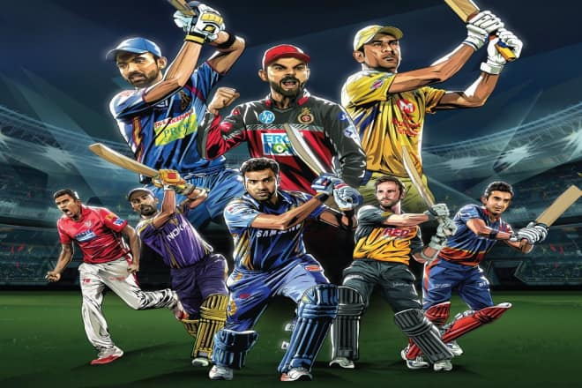

Indian Premier League IPL
M Ravi Shankar (April 2019)

Slide 2
Indian Premier League
Indian Premier League (IPL) is one of the most popular cricket tournaments in the world, organized by BCCI.
Cricket is a bat-and-ball game played between two teams of eleven players each on a cricket field, at the centre of which is a rectangular 20-metre (22-yard) pitch with a target at each end called the wicket (a set of three wooden stumps upon which two bails sit).
The Indian Premier League (IPL), is a professional franchise-based Twenty20 cricket league in India contested during April and May of every year by teams representing 8 Indian cities and some states. The league was founded by the Board of Control for Cricket in India (BCCI) in 2008.
Currently, with eight teams, each team plays each other twice in a home-and-away round-robin format in the league phase. At the conclusion of the league stage, the top four teams will qualify for the playoffs. The top two teams from the league phase will play against each other in the first Qualifying match, with the winner going straight to the IPL final and the loser getting another chance to qualify for the IPL final by playing the second Qualifying match. Meanwhile, the third and fourth place teams from league phase play against each other in an eliminator match and the winner from that match will play the loser from the first Qualifying match.
The winner of the second Qualifying match will move onto the final to play the winner of the first Qualifying match in the IPL Final match, where the winner will be crowned the Indian Premier League champions. The squad strength must be between 18 and 25 players, with a maximum of 8 overseas players. A team can play a maximum of 4 overseas players in their playing eleven.

Slide 3
Data Source
The dataset consists of the information about IPL (Indian Premier League). It comprises of 696 observations of 18 columns.
Various variables present in the dataset includes id, season, city, team1, team2, venue, umpire1, umpire2, win_by_wicket and win_by_runs etc.
Primary Observations
Data types available in the dataset
  Numeric : id, Season, win_by_wicket, win_by_runs and dl_applied.
  Object: City, team1, team2, venue, umpire1, umpire2
Season column has 11 distinct values. IPL matches data is for 11 seasons from 2008 till 2018.
Result column has 3 distinct values. There are 7 ties and no result for 3 matches.
dl_applied has 2 distinct values. 0 as 'No' and 1 as 'Yes'. There are total 19 matches (2.7%) results declared based on Duckworth Lewis method.
City column has total 33 distinct values and 7 missing values. This should not null. Check the records where city is null and see venue of the match. Based on that fill city information.
Winner column has 3 missing values. This should be null for the matches when there is 'no result'. If that is the case replace null with 'None'.
player_of_match column has There are 3 missing values. This should be null for the matches when there is 'no result'. If that is the case replace null with 'None'. These might be the same records where winner has missing values.
umpire1 and umpire2: column has 1 missing values. We need to replace null with appropriate value.
Umpire3 column has 91.4 % missing values. This column can be dropped for further data analysis

Slide 4
Pre Processing
Data Issue
City column has 7 missing values.
Winner and player_of_matches has 3 missing values.
Umpire1 and Umpire2 has 1 missing value. (match played on 2017-04-08).
Umpire3 has 91.4% missing values.
There are 7 tied matches. Since match is 'tie', there should not be any winner. But these 7 records has 'winner' values.
Team name contain 'Rising Pune Supergiants' and 'Rising Pune Supergiant' both are same team.

Slide 5
Problem Statement
Indian Premier League (IPL)is one of the most popular tournaments in the world. There is a huge franchise money involved in IPL, hence there is lot of pressure on team management and players to perform well in every match.
Always they need to strive for excellence by taking appropriate decisions in selecting players, understanding oppositions strong and weak points, studying pitch conditions. All these will be possible only by studying the historical data.

Slide 6
Exploratory Data Analysis
After initial analysis along with data profiling, we got know to that we have columns with null values and data error in some of the columns.
Assumptions
Assuming that there is no 'Super over' after match is 'tie', since super over data is not available. So considering that there is no 'winner' for 'tie' result matches.
Matches for which there is 'no result' means match has been abandoned. So no winner for the match. These records will be dropped for further analysis.
Data Normalization
Replaced team data from “Rising Pune Supergiants” to “Rising Pune Supergiant”
Since match is ‘tie', there should not be any winner. Updated data for ‘tie’ matches for “winner” to “None”.
For Dubai International Cricket Stadium venue record, city has null value. Replaced null value with Dubai.
For 3 matches we have missing values in ‘winner’ and ‘palyer_of_match’ columns and we replaced with None as these were matches were ended with no results.
Dropped ‘umpire3’ column since it has 91.4% missing values.
Assigned values for ‘umpire1’ and ‘umpire2’ record which has missing value.

Slide 7
Exploratory Data Analysis
After data normalization, did further analysis using below questions.
How many matches we’ve got in the dataset?
How many seasons we’ve got in the dataset?
Which is the most successful IPL Team?
Who are the top players of matches?
Which Team had won by maximum runs?
Which Team had won by maximum wicket?
Has Toss-winning helped in winning matches?
Which Season had most number of matches?
Number of matches played in different cities?
Which stadium is best suitable for first batting?
Which stadium is best suitable for first bowling?
Matches played and matches won by each team?
How team has won the match when Duckworth Lewis method was applied.
Establish a correlation between all the features using heatmap

Slide 8
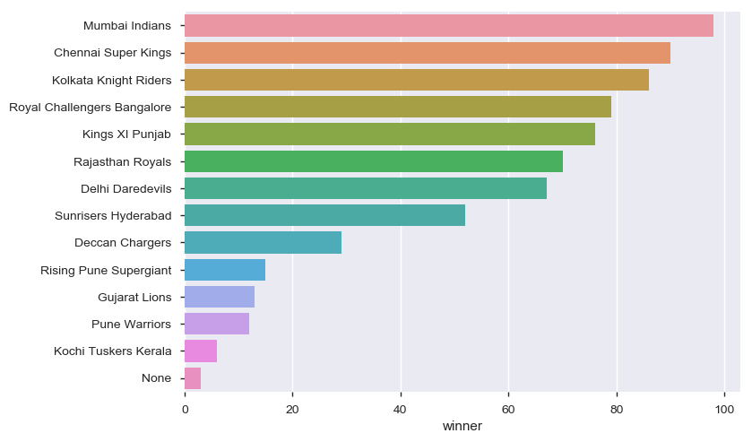
Most Successful IPL Team
Mumbai Indians is most successful IPL Team, has won 90 matches overall in IPL.

Slide 9
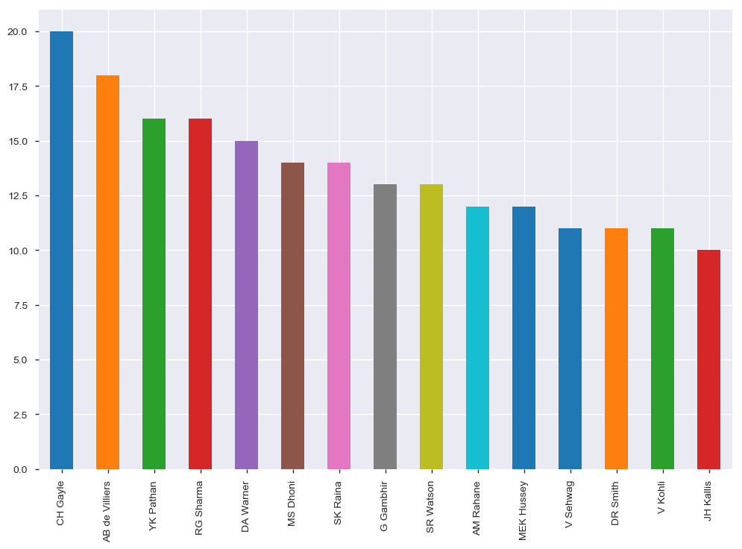
Top IPL Players
Chris Gayle, ABD and Yusuf Pathan are top 3 IPL players. Surprisingly in 2018 Gayle didn’t got
auctioned in first round.

Slide 10
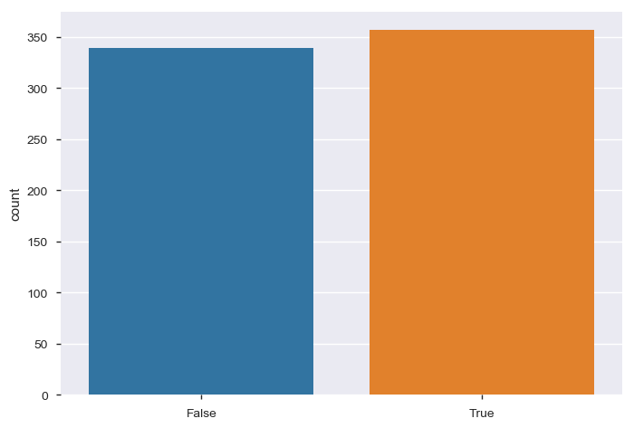
Has toss winning helped the team in winning match
With above graph we can assume there is strong correlation between toss and match winning.

Slide 11
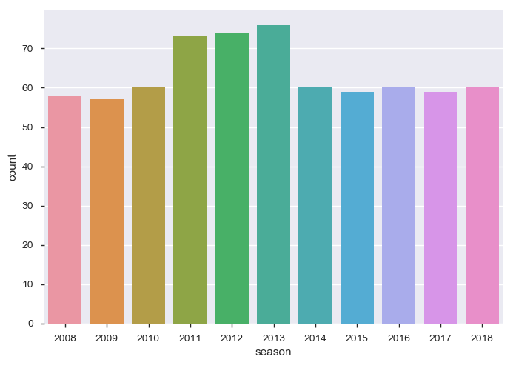
Which season had most number of matches
In 2013 most number of matches were played.

Slide 12
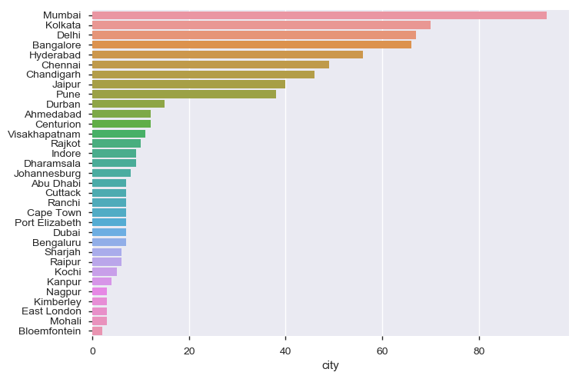
Number of matches played in different City
In Mumbai most number of matches were played.

Slide 13
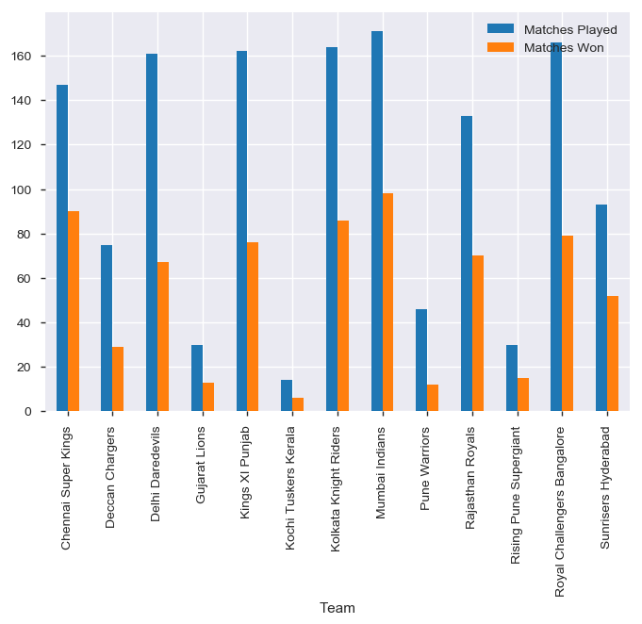
Matches played and won by each team
Mumbai and Chennai are the top 2 teams with regards to winning the matches.
Chennai has 61% and Mumbai has 57% winning ratio.

Slide 14
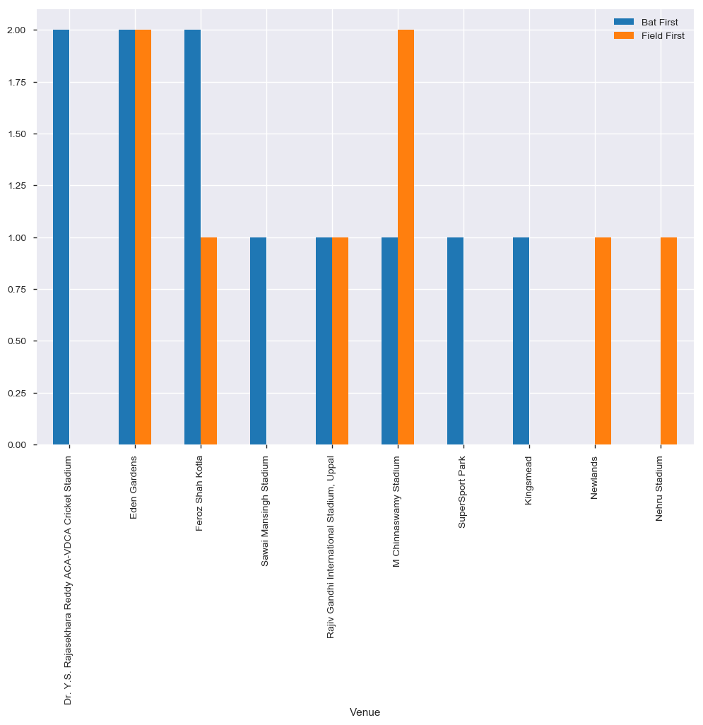
How team has won the match when Duckworth Lewis method was applied
If there is a rain forecast based on the past record batting first/bowling first has to be decided by toss winners.

Slide 15
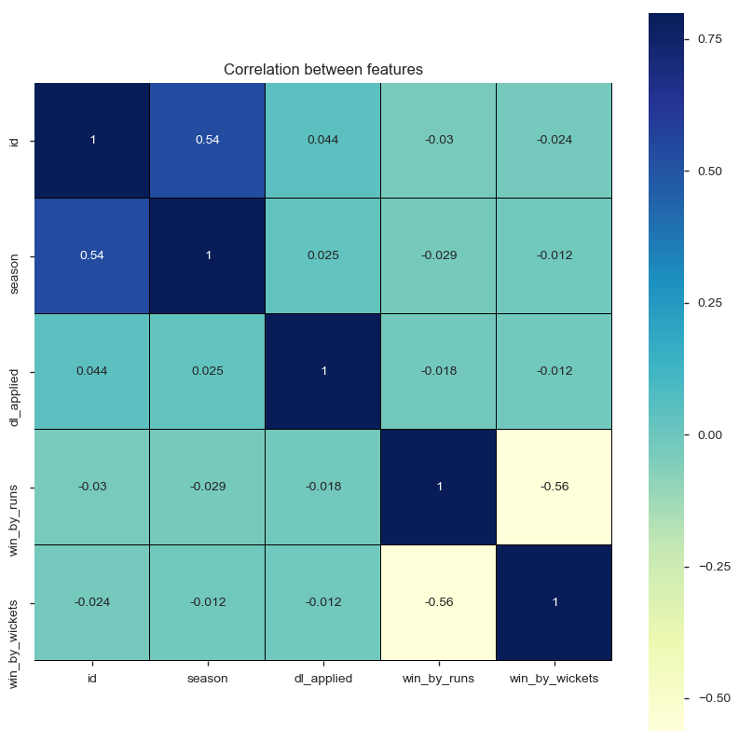
Establish correlation between all the features using heat map
With above heat map we can say win_by_runs and win_by_wicket have negative correlation.

Slide 16
Conclusion
Mumbai Indians, Chennai Super Kings and Kolkata Knight Riders are the most successful teams in IPL. (Slide 8)
Bengaluru, Kolkata, Delhi, Mumbai and Hyderabad are the venues where more than 50 matches has been played in IPL in 11 seasons. (Slide 12)
Mumbai Indians has won more number of matches in IPL. (Slide 13).
CH Gayle, AB de Villiers, YK Pathan and RG Sharma are top performers of the teams and has won maximum Man of the Match Awards.(Slide 9)
From the analysis, it has concluded that below are the factors to win the matches.
Opposition Team, venue and winning the toss are some of the factors to win the match.
  Toss winner has won only 51.6% of the IPL matches. So just winning the toss is not the complete criteria for winning the match.
  Team Field first has won 54.1% of the matches while batting first team has won 45.9% of the matches.

Slide 17
Conclusion
  After winning the toss, selecting Bat First or Field First is also the important factor.
  Kolkata Knight Riders, Royal Challengers Bangalore, Rajasthan Royals and Delhi Daredevils has won most of the matches when they Field First. So they are good in chasing the score as compared to other teams.
  Another criteria is pitch (matches played at venue) past record of winning team, to decide whether to Bat First or to select Field first.
  Rain Forecast (Duckworth Lewis method), as seen in (Slide 14), if there is Rain forecast in the venue then based on past winning record, team has to decide whether to Bat First or Field First after winning the toss.
  Selection of Top performer players. Sections (Slide 9) provides information about top performers in IPL.

